Slide 1
TRATTAMENTO MULTIMODALE COME GARANZIA DI SUCCESSO
Amanda belluzzi, MD
U.O.C. chirurgia generale, Ospedale S. Maria della Misericordia, Rovigo

Slide 2
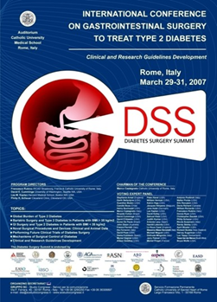
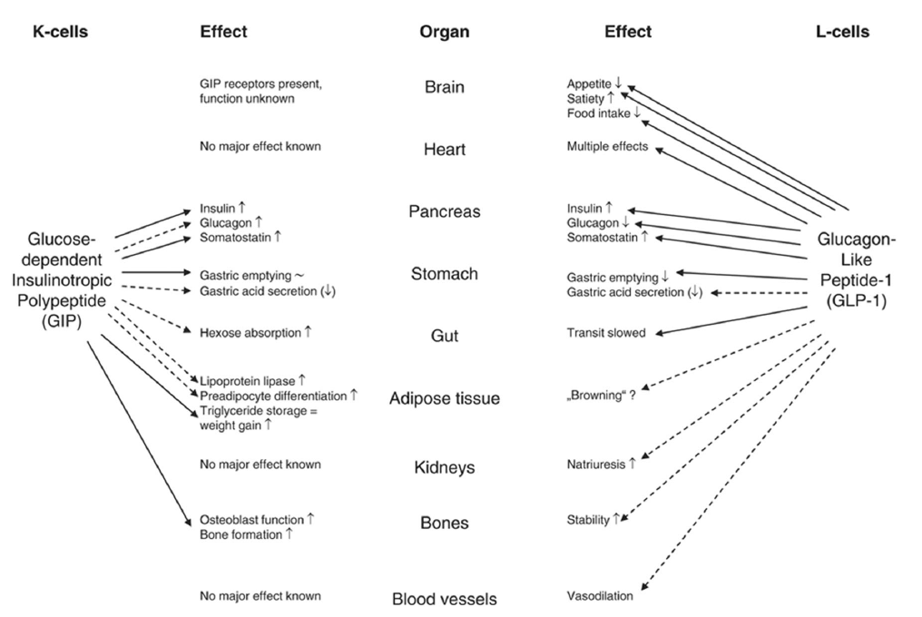
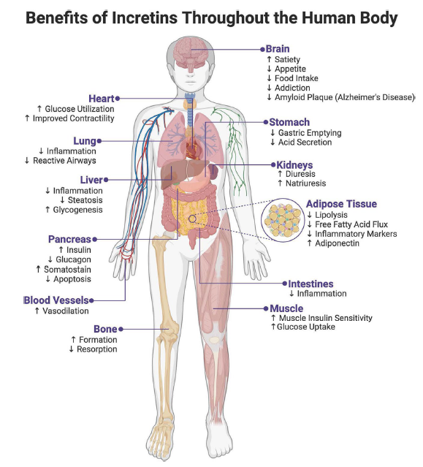
Trattamento Multimodale come Garanzia di Successo
The realization that mechanisms and benefits of bariatric surgery extend beyond weight loss questions the appropriateness of the name and purpose of a surgical practice historically modeled around weight reduction.
At the 2007 Rome Diabetes Surgery Summit, a group of leading international scholars first recommended consideration of gastrointestinal surgery to intentionally treat type 2 diabetes (“diabetes surgery”). After that meeting, the concept of “metabolic surgery” has rapidly emerged to more broadly indicate a surgical approach aimed at the control of metabolic illnesses, not just excess weight.
Dubin RL, Heymsfield SB, Ravussin E, Greenway FL. Glucagon-like peptide-1 receptor agonist-based agents and weight loss composition: Filling the gaps. Diabetes Obes Metab. 2024 Dec;26(12):5503-5518
Kaplan JM, Zaman A, Abushamat LA. Curbing the Obesity Epidemic: Should GLP-1 Receptor Agonists Be the Standard of Care for Obesity? Curr Cardiol Rep. 2024 Sep;26(9):1011-1019.

Slide 3
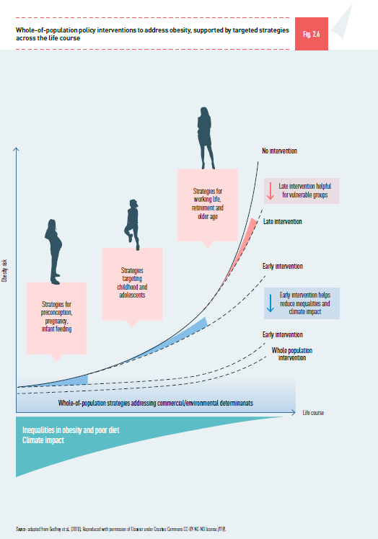
Trattamento Multimodale come Garanzia di Successo
Whole-of-population policy interventions to address obesity, supported by targeted strategies across the life course
Godfrey KM, Gluckman PD, Hanson MA. Developmental origins of metabolic disease: life course and intergenerational perspectives. Trends Endocrinol Metab. 2010;21(4):199–205.

Slide 4
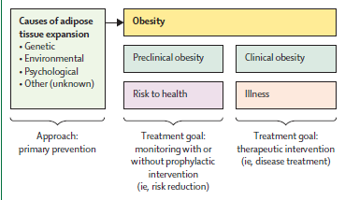
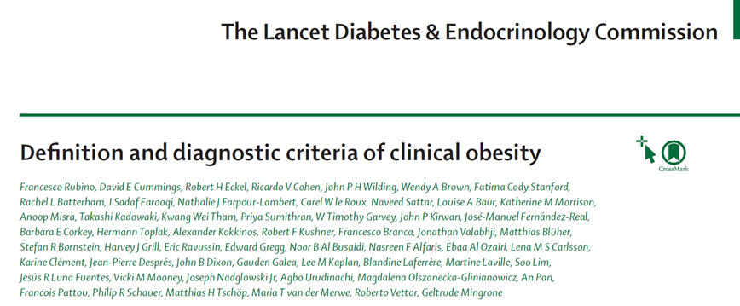
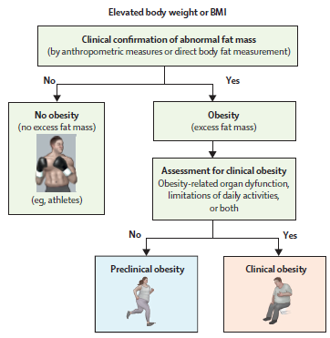
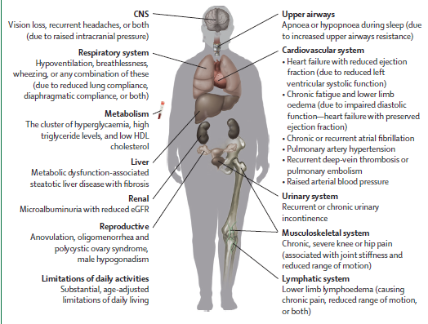
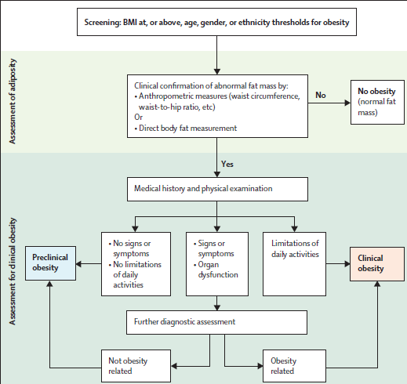
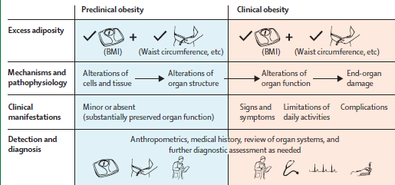
Trattamento Multimodale come Garanzia di Successo
2025
Rubino F et al. Definition and diagnostic criteria of clinical obesity. Lancet Diabetes Endocrinol. 2025 Jan 9:S2213-8587(24)00316-4.

Slide 5
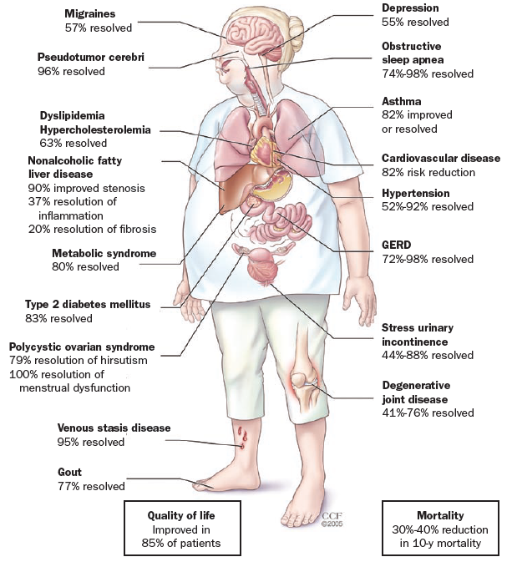
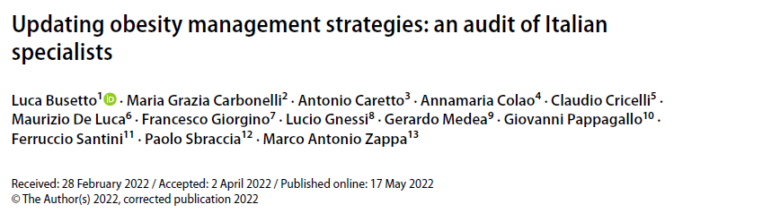
Trattamento Multimodale come Garanzia di Successo
2022
In clinical practice, it seems inappropriate to delay an intervention that could avoid progression to a more severe level of obesity and/or prevent the onset of obesity-related medical conditions.
Obesity is increasingly being recognized as a treatable chronic disease. Although there is increasing interest in early diagnosis and timely intervention, several aspects of the current guidelines for clinical management of obesity are not at pace with a more advanced management of this disease.
Clinicians should shift from a stepwise approach focused on BMI alone to a more advanced approach in which the intensity of therapeutic intervention is based on a complete evaluation of the obesity status and promptly adjusted to the patient’s needs and therapeutic targets.
Busetto L, Carbonelli MG, Caretto A, Colao A, Cricelli C, De Luca M, Giorgino F, Gnessi L, Medea G, Pappagallo G, Santini F, Sbraccia P, Zappa MA. Updating obesity management strategies: an audit of Italian specialists. Eat Weight Disord. 2022 Oct;27(7):2653-2663.
Schwartz SS, Kohl BA. Glycemic control and weight reduction without causing hypoglycemia: the case for continued safe aggressive care of patients with type 2 diabetes mellitus and avoidance of therapeutic inertia. Mayo Clin Proc. 2010 Dec;85(12 Suppl):S15-26.

Slide 6
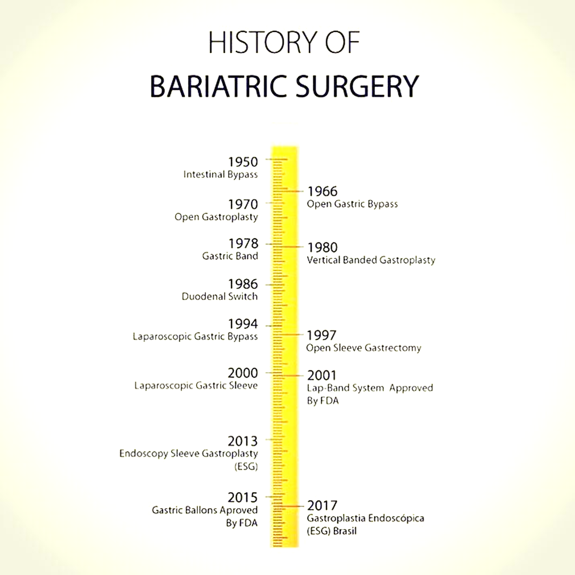
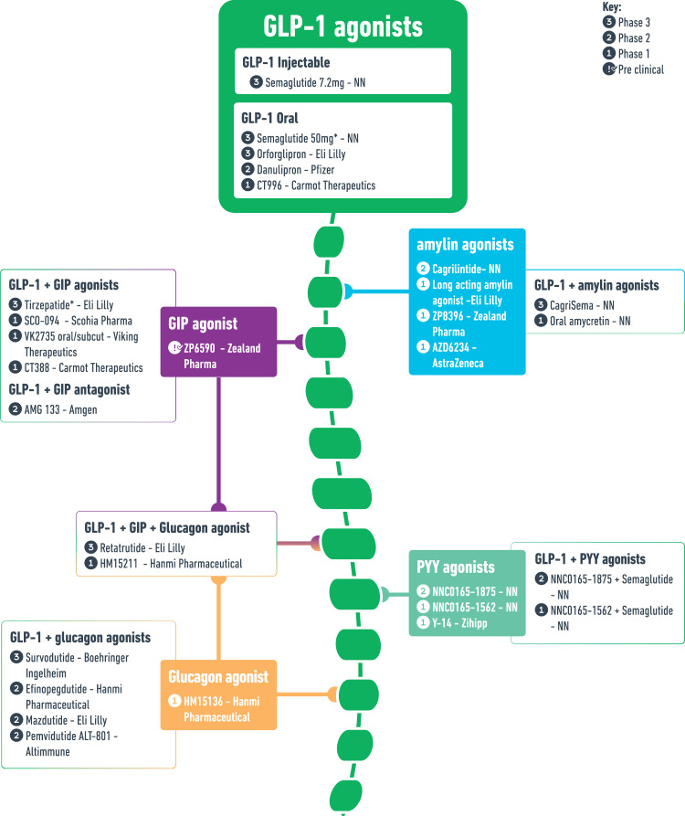
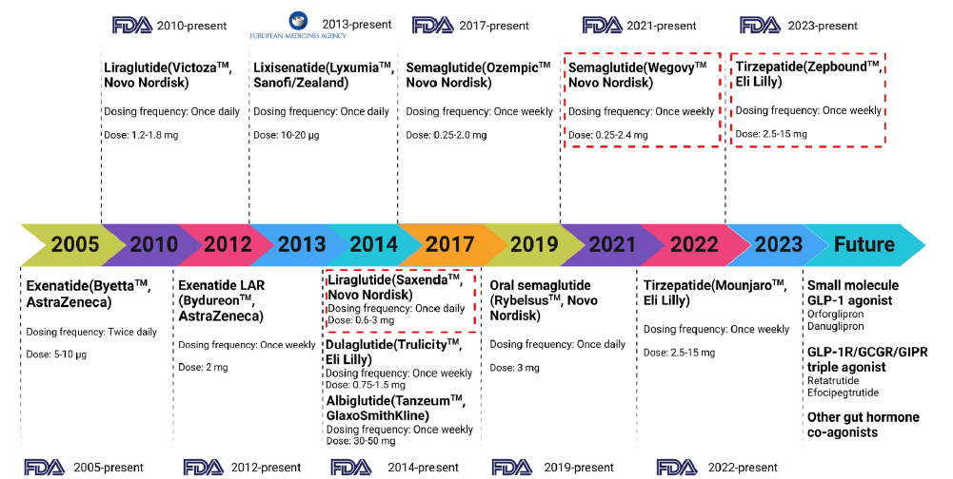
Trattamento Multimodale come Garanzia di Successo
Different timelines of OMM and MBS procedures
2020
Transit Bipartition (first described by Santoro in 2001)
Melson E, Ashraf U, Papamargaritis D, Davies MJ. What is the pipeline for future medications for obesity? Int J Obes (Lond). 2025 Mar;49(3):433-451.
Gong B, Yao Z, Zhou C, Wang W, Sun L, Han J. Glucagon-like peptide-1 analogs: Miracle drugs are blooming? Eur J Med Chem. 2024 Apr 5;269:116342.

Slide 7
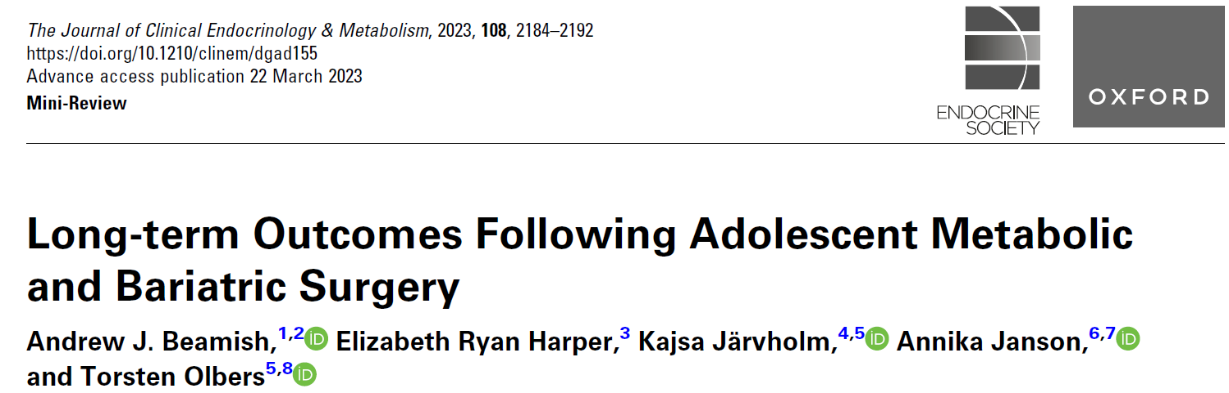
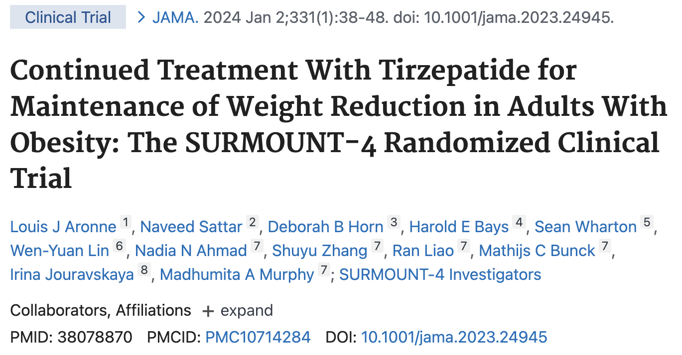
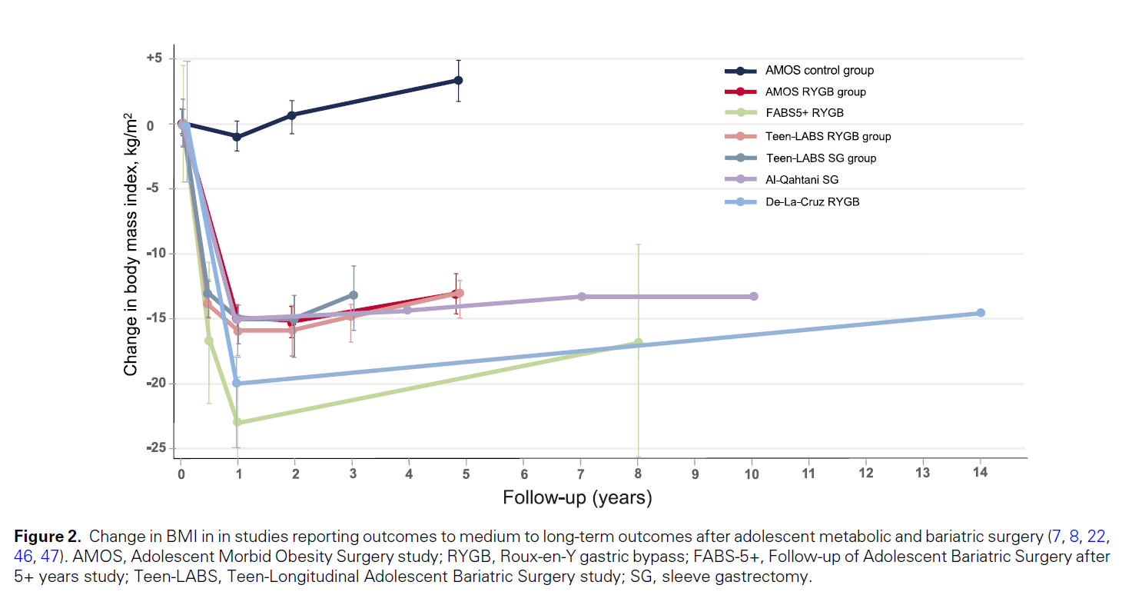
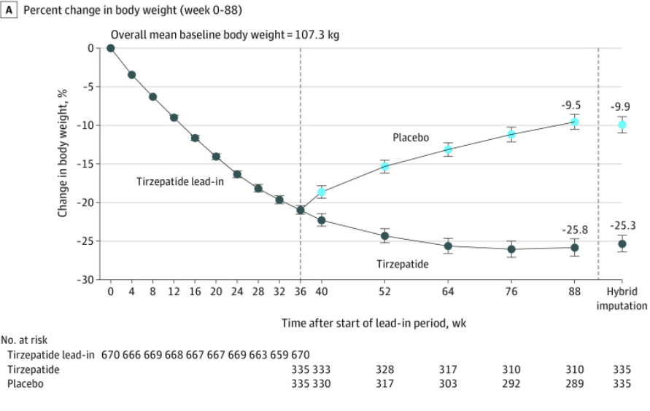
Trattamento Multimodale come Garanzia di Successo
What do you mean for weight regain?
2023
2024
Beamish AJ, Ryan Harper E, Järvholm K, Janson A, Olbers T. Long-term Outcomes Following Adolescent Metabolic and Bariatric Surgery. J Clin Endocrinol Metab. 2023 Aug 18;108(9):2184-2192.
Inge TH, Courcoulas AP, Jenkins TM, et al. Five-year outcomes of gastric bypass in adolescents as compared with adults. N Engl J Med. 2019;380(22):2136-2145.
Olbers T, Beamish AJ, Gronowitz E, et al. Laparoscopic Roux-en-Y gastric bypass in adolescents with severe obesity (AMOS): a prospective five-year Swedish nationwide study. Lancet Diabetes Endocrinol. 2017;5(3):174-183.
Inge TH, Courcoulas AP, Jenkins TM, et al. Weight loss and health status 3 years after bariatric surgery in adolescents. N Engl J Med. 2016;374(2):113-123.
Inge TH, Jenkins TM, Xanthakos SA, et al. Long-term outcomes of bariatric surgery in adolescents with severe obesity (FABS-5+): a prospective follow-up analysis. Lancet Diabetes Endocrinol. 2017;5(3):165-173.
Alqahtani AR, Elahmedi MO, Al Qahtani AR, Lee J, Butler MG. Laparoscopic sleeve gastrectomy in children and adolescents with Prader-Willi syndrome: a matched-control study. Surg Obes Relat Dis. 2016;12(1):100-110.
de la Cruz-Muñoz N, Xie L, Quiroz HJ, et al. Long-term outcomes after adolescent bariatric surgery. J Am Coll Surg. 2022;235(4): 592-602.
Aronne LJ, Sattar N, Horn B, Bays HE et al.
Continuead Treatment with Tirzepatide for Maintainance of weight Reduction in Adults with Obesity: The SURMOUNT–4 Randomized Clinical Trial
Jama, 2024 Jan 2; 331 (1): 38-48 doi:10100/iama2023.24945

Slide 8
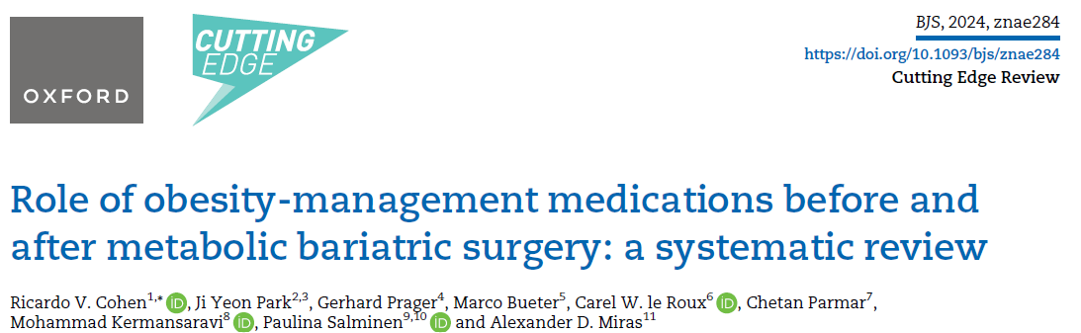
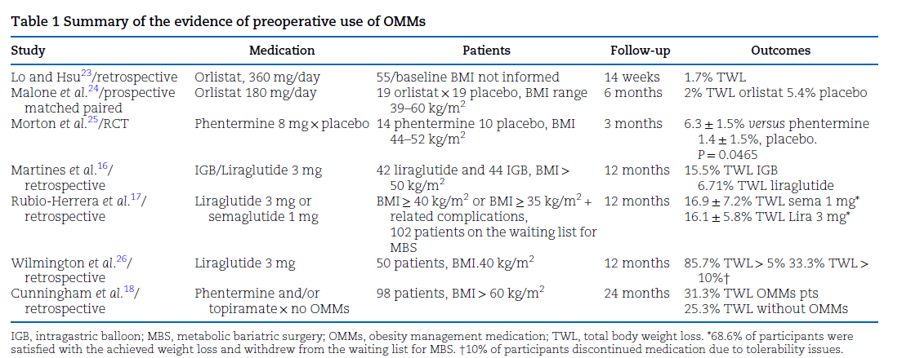
Trattamento Multimodale come Garanzia di Successo
2024
Cohen RV, Park JY, Prager G, Bueter M, le Roux CW, Parmar C, Kermansaravi M, Salminen P, Miras AD.. Role of obesity-management medications before and after metabolic bariatric surgery: a systematic review. Br J Surg. 2024 Nov 27;111(12)

Slide 9
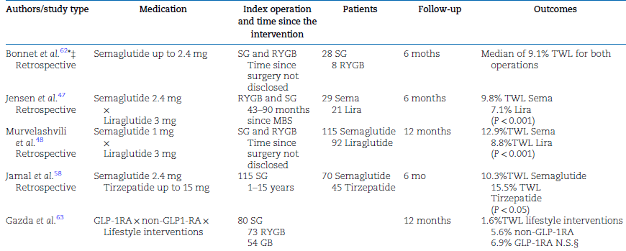
2024
Cohen RV, Park JY, Prager G, Bueter M, le Roux CW, Parmar C, Kermansaravi M, Salminen P, Miras AD. Role of obesity-management medications before and after metabolic bariatric surgery: a systematic review. Br J Surg. 2024 Nov 27;111(12)

Slide 10
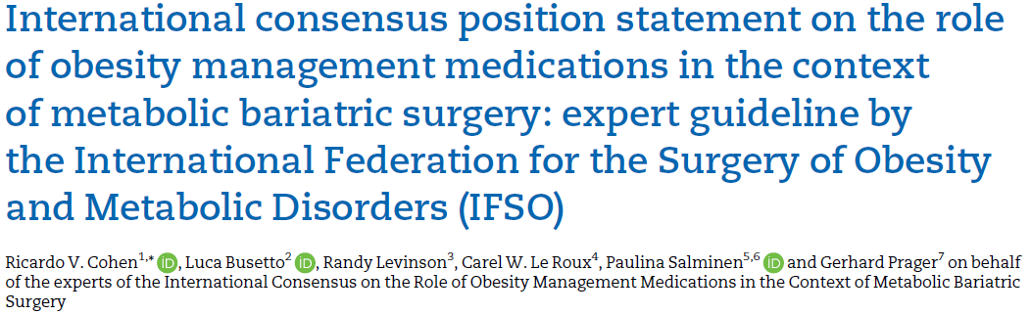
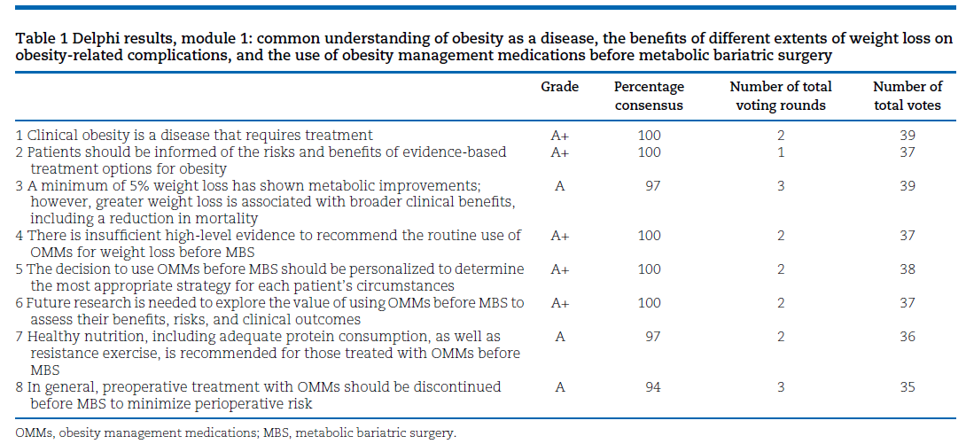
Trattamento Multimodale come Garanzia di Successo
2024
Cohen RV, Busetto L, Levinson R, Le Roux CW, Salminen P, Prager G; International Consensus on the Role of Obesity Management Medications in the Context of Metabolic Bariatric Surgery. International consensus position statement on the role of obesity management medications in the context of metabolic bariatric surgery: expert guideline by the International Federation for the Surgery of Obesity and Metabolic Disorders (IFSO). Br J Surg. 2024 Nov 27;111(12)

Slide 11
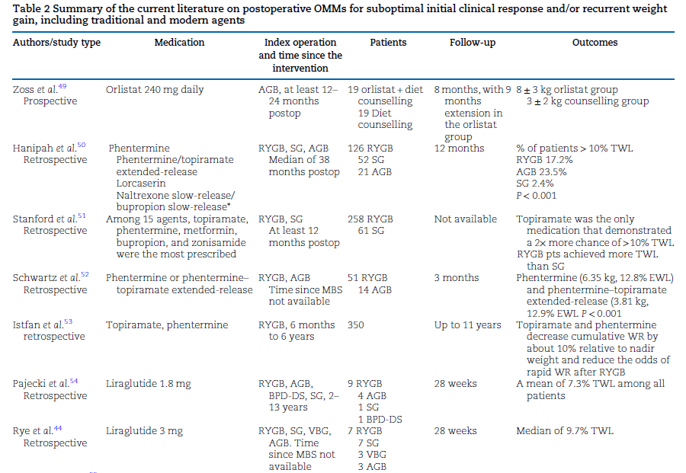
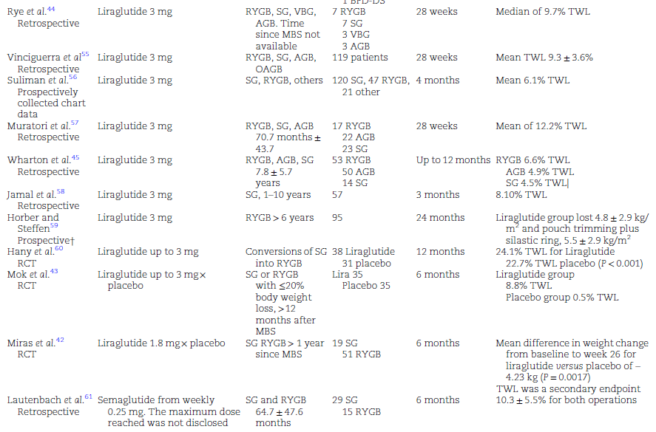
Trattamento Multimodale come Garanzia di Successo
2024
Cohen RV, Park JY, Prager G, Bueter M, le Roux CW, Parmar C, Kermansaravi M, Salminen P, Miras AD.. Role of obesity-management medications before and after metabolic bariatric surgery: a systematic review. Br J Surg. 2024 Nov 27;111(12)

Slide 12

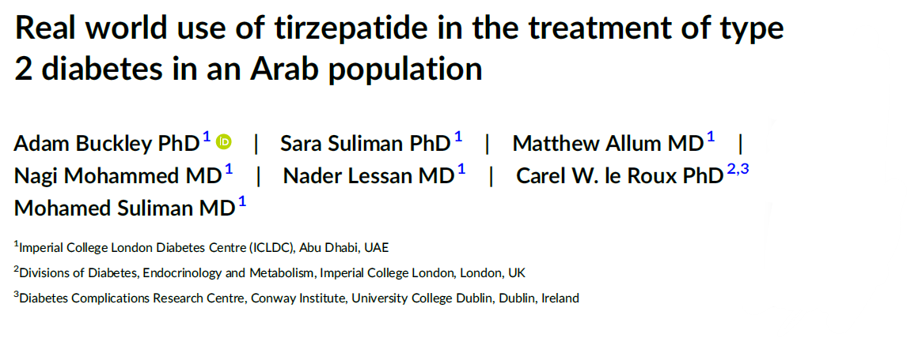
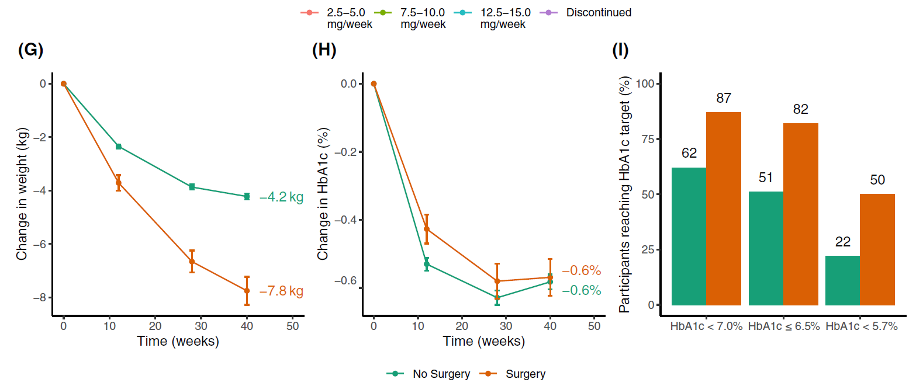
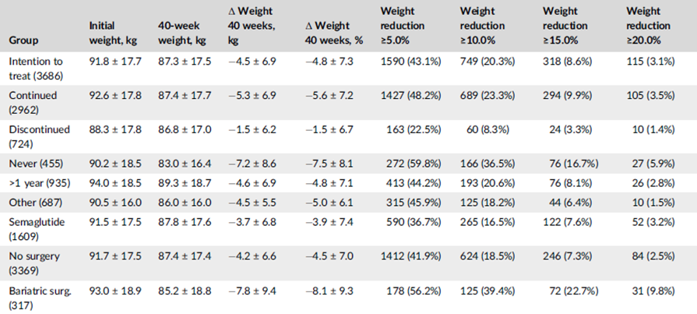
Trattamento Multimodale come Garanzia di Successo
2024
2024
The mean weight at baseline was 93.0 ± 18.8 kg in the MBS group and 91.7 ± 17.5 kg in the NoS group (p = .24, not significant). The mean reduction in weight at 40 weeks was 7.8 ± 9.4 kg in the MBS group compared with 4.2 ± 6.6 kg in the NoS group (p < .0001)
The mean HbA1c at initiation was 6.5 ± 1.3% in 317 individuals with a previous history of MBS, compared with 7.4 ± 1.5% in 3369 individuals without (NoS) (p < .0001).
At 40 weeks, the mean reduction in HbA1c was 0.6 ± 1.0% in the MBS group and 0.6 ± 1.3% in the NoS group (p = .81). At 40 weeks, 87.1% of individuals in the MBS group had HbA1c <7.0%, compared with 61.9% in the NoS group, although, importantly, a larger proportion in the baseline group were already at this target at baseline (75.7%; NoS: 44.3%)
Nagendra L, Dutta D, Kamrul-Hasan ABM. Bariatric surgery and tirzepatide-Friends, not foes! Diabetes Obes Metab. 2024 Oct;26(10):4806. Buckley A, Suliman S, Allum M, Mohammed N, Lessan N, le Roux CW, Suliman M. Real world use of tirzepatide in the treatment of type 2 diabetes in an Arab population. Diabetes Obes Metab. 2024 Aug;26(8):3381-3391.

Slide 13
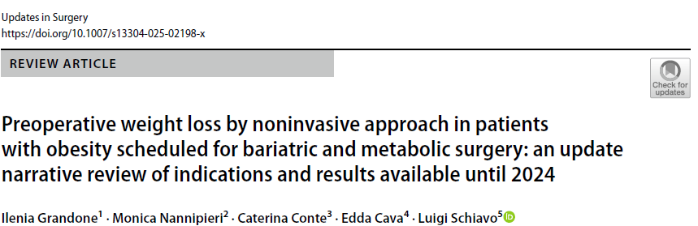
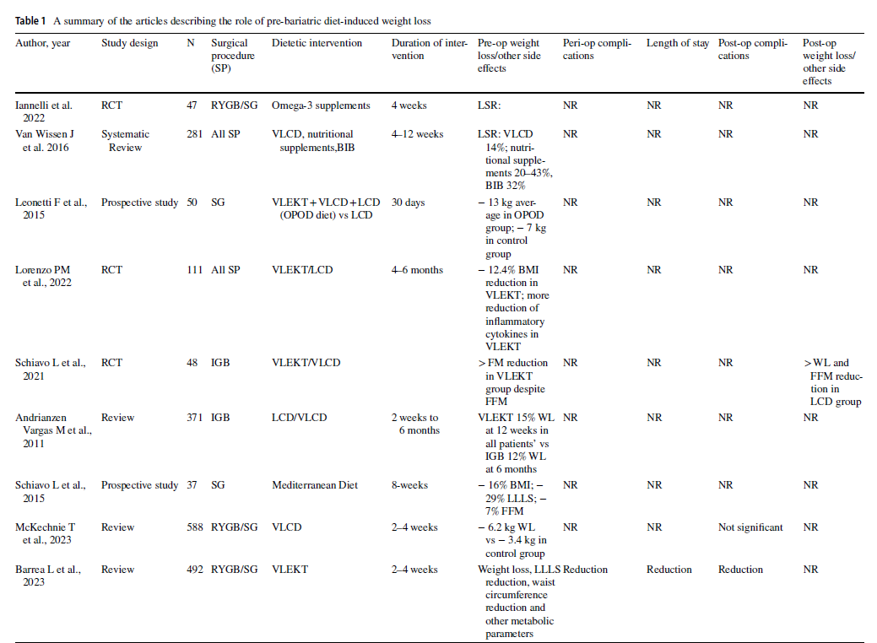
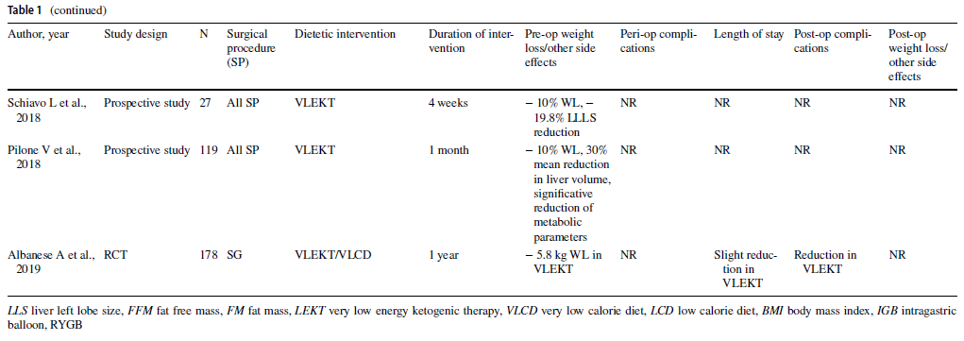
Trattamento Multimodale come Garanzia di Successo
2025
Grandone I, Nannipieri M, Conte C, Cava E, Schiavo L. Preoperative weight loss by noninvasive approach in patients with obesity scheduled for bariatric and metabolic surgery: an update narrative review of indications and results available until 2024. Updates Surg. 2025 Apr 12.

Slide 14
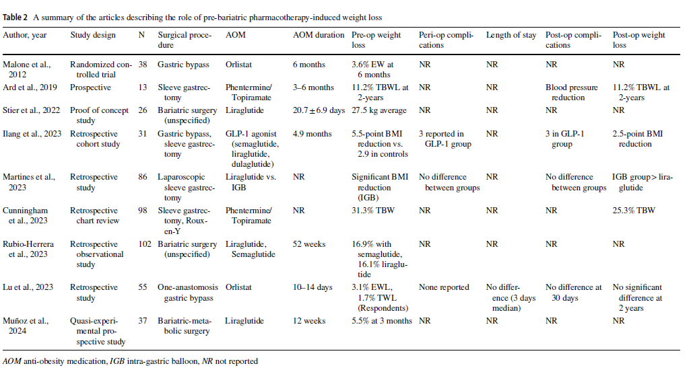
Trattamento Multimodale come Garanzia di Successo
Grandone I, Nannipieri M, Conte C, Cava E, Schiavo L. Preoperative weight loss by noninvasive approach in patients with obesity scheduled for bariatric and metabolic surgery: an update narrative review of indications and results available until 2024. Updates Surg. 2025 Apr 12.

Slide 15
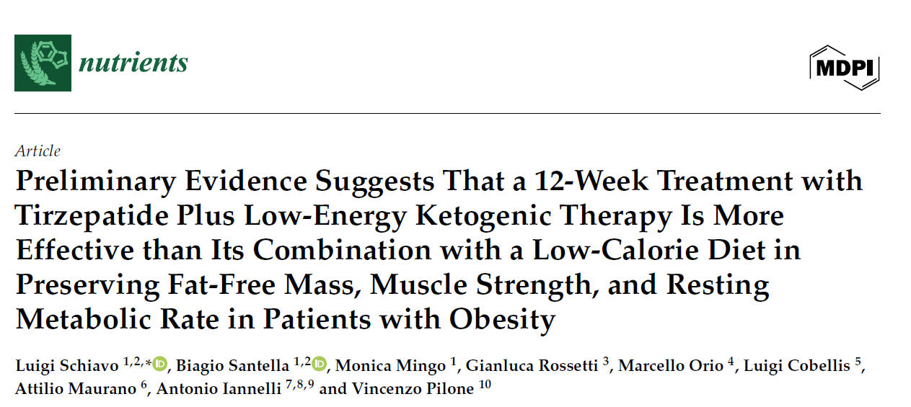
Trattamento Multimodale come Garanzia di Successo
2025
Prospective comparison of the effects of TZP combined with either an LCD or LEKT in 60 patients with obesity (n = 30 per group) over 12 weeks. BW, FM, FFM, MS, and RMR were measured at baseline and after 12 weeks.
At 12-week follow-up, both groups showed a significant BW reduction from baseline, p<0.05), with no significant intergroup difference (p = 0.665). Similarly, FM decreased significantly in both with the TZP+LEKT group achieving a significant greater FM loss .
However, the TZP+LCD group exhibited significant declines from baseline in FFM ,MS and RMR (p < 0.001), whereas any significant changes in FFM,MS and RMR were reported in the TZP+LEKT group.
Intergroup direct comparisons confirmed that the TZP+LCD group experienced significantly greater reductions in FFM.
TZP+LEKT seems to be superior to TZP+LCD in promoting FM reduction while preserving FFM, MS, and RMR in patients with obesity.
LEKT = Low-Energy Ketogenic Therapy;
TZP = Tirzepatide;
LEC = low-calorie diet;
TBW = total body weight;
FM = fat mass;
FFM = fat-free mass;
MS = muscle strength;
RMR = resting metabolic rate.
Schiavo L, Santella B, Mingo M, Rossetti G, Orio M, Cobellis L, Maurano A, Iannelli A, Pilone V. Preliminary Evidence Suggests That a 12-Week Treatment with Tirzepatide Plus Low-Energy Ketogenic Therapy Is More Effective than Its Combination with a Low-Calorie Diet in Preserving Fat-Free Mass, Muscle Strength, and Resting Metabolic Rate in Patients with Obesity. Nutrients. 2025 Mar 30;17(7):1216.

Slide 16
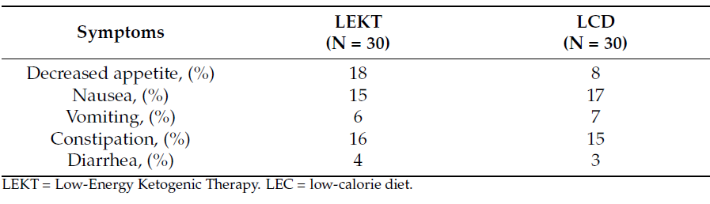
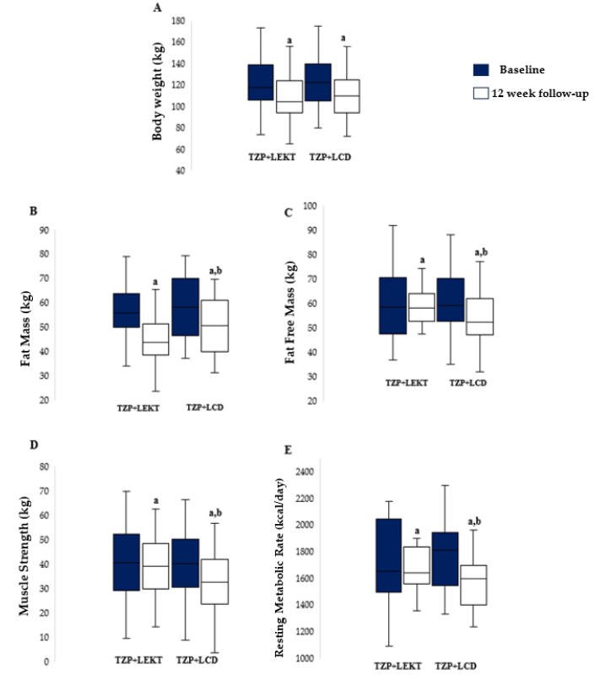
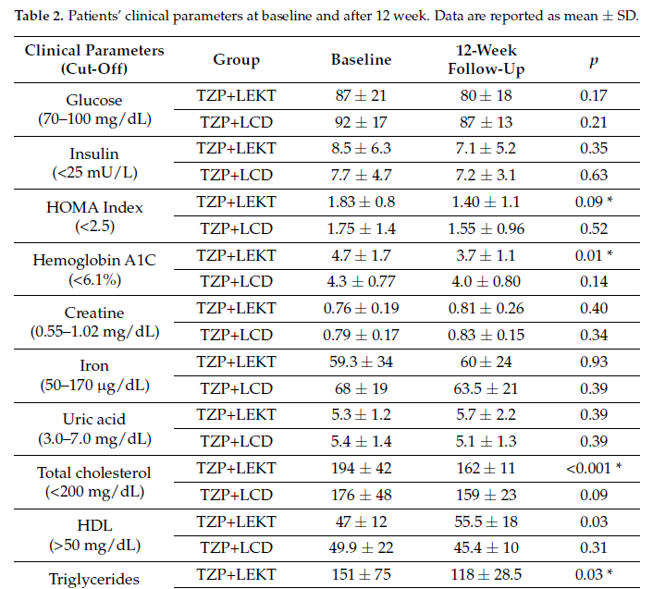
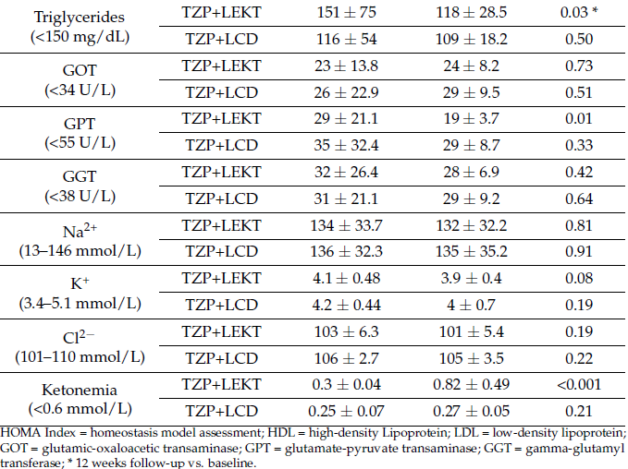
Trattamento Multimodale come Garanzia di Successo
2025
Schiavo L, Santella B, Mingo M, Rossetti G, Orio M, Cobellis L, Maurano A, Iannelli A, Pilone V. Preliminary Evidence Suggests That a 12-Week Treatment with Tirzepatide Plus Low-Energy Ketogenic Therapy Is More Effective than Its Combination with a Low-Calorie Diet in Preserving Fat-Free Mass, Muscle Strength, and Resting Metabolic Rate in Patients with Obesity. Nutrients. 2025 Mar 30;17(7):1216.

Slide 17
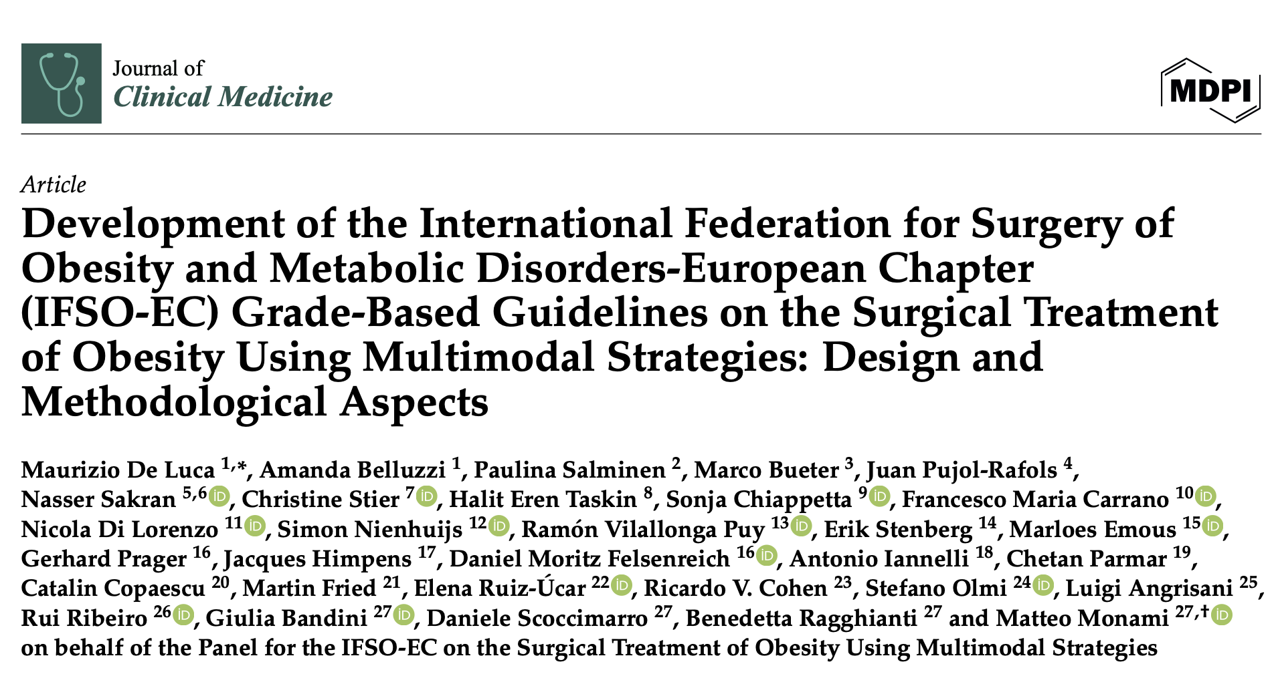
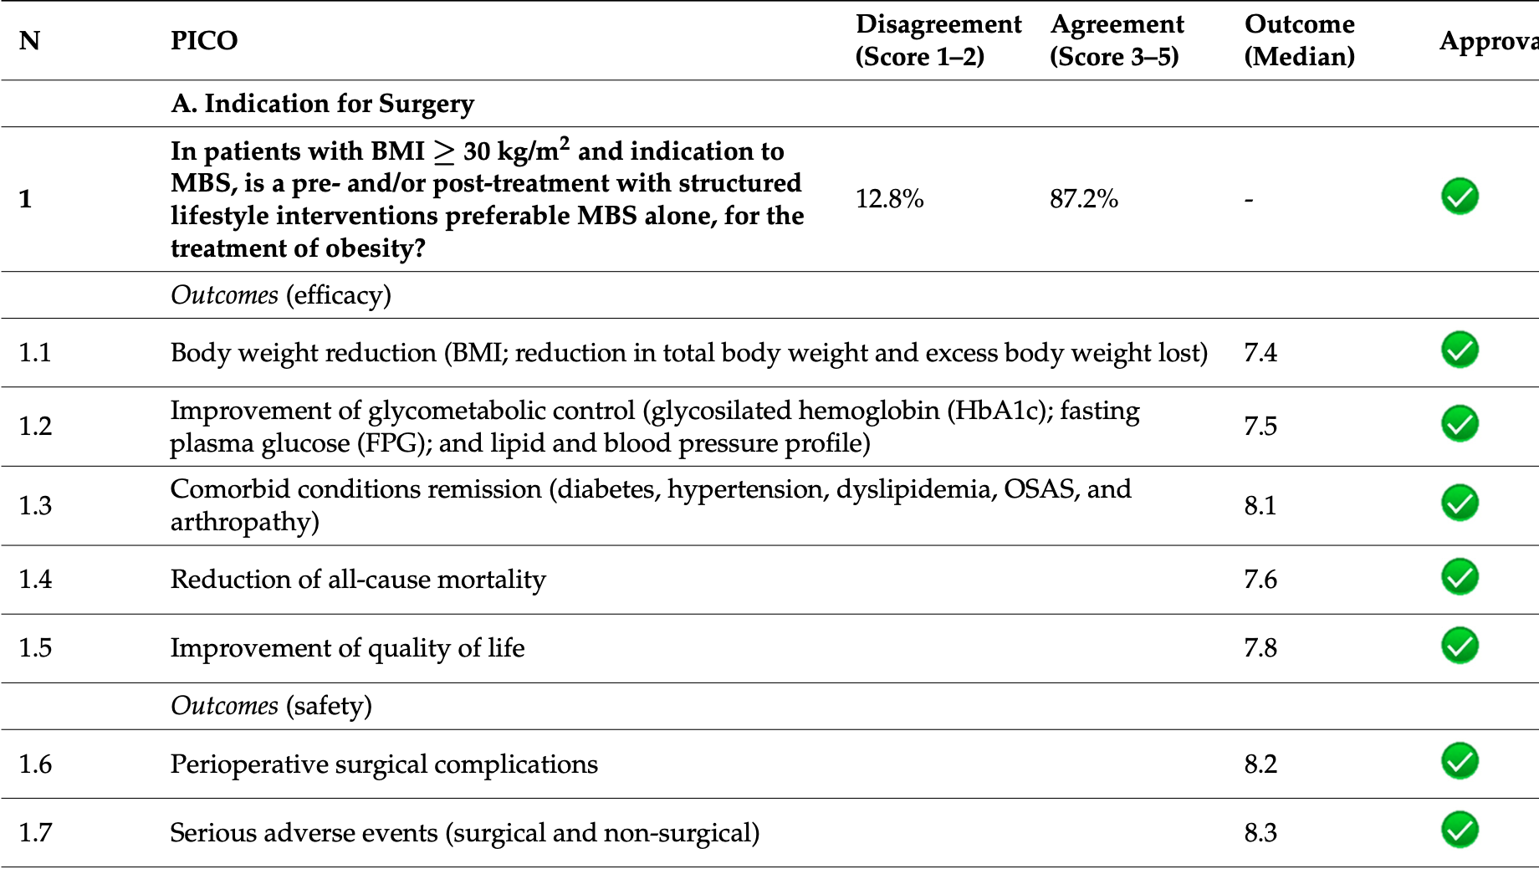
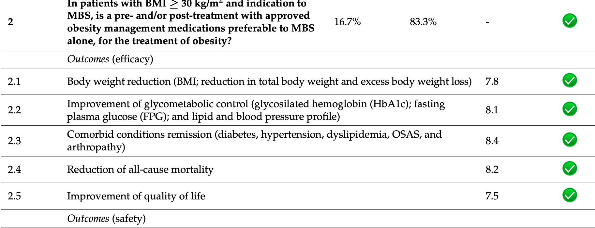
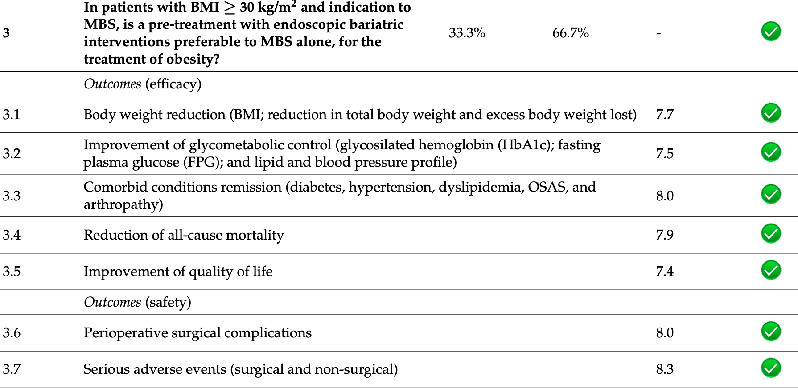
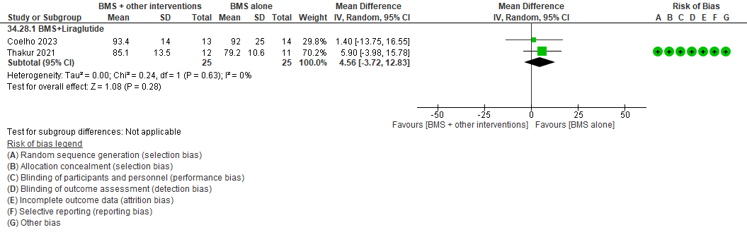
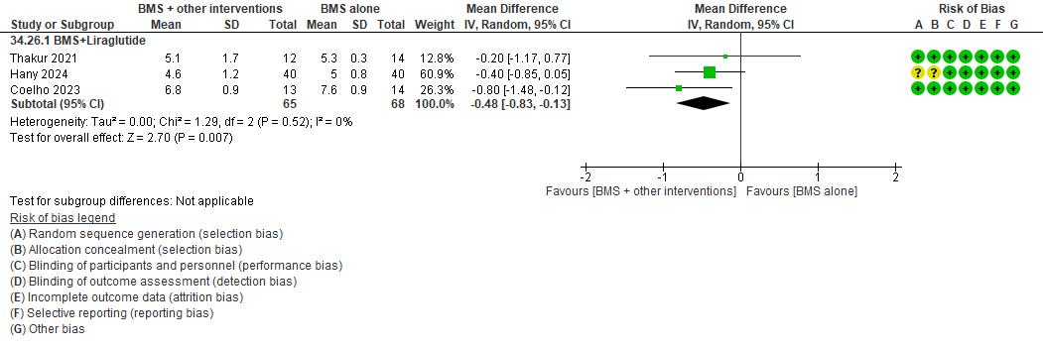
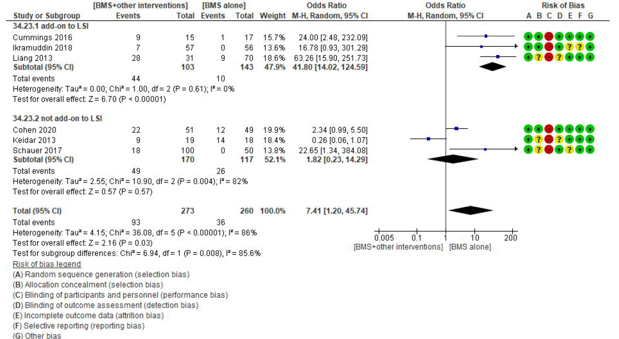
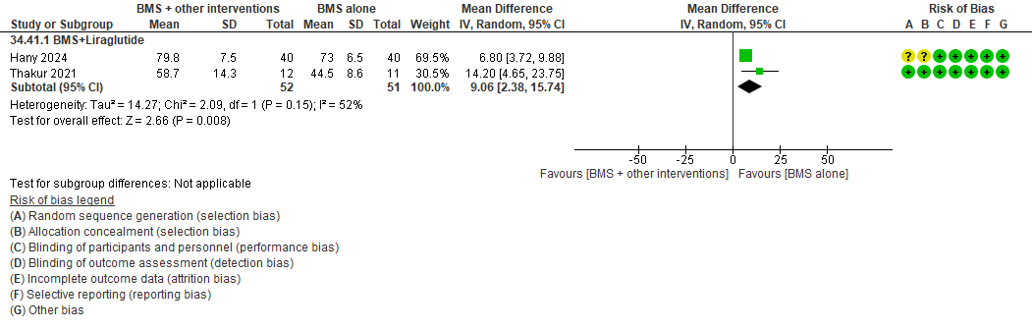
Trattamento Multimodale come Garanzia di Successo
2024
Figure 3S – Effects of metabolic surgery add-on to other anti-obesity strategies in comparison with BMS alone on excess body weight lost (EBWL%).
Figure 4S – Effects of metabolic surgery add-on to other anti-obesity strategies in comparison with BMS alone on total body weight lost (TBWL).
Figure 6S – Effects of metabolic surgery add-on to other anti-obesity strategies in comparison with BMS alone on endpoint HbA1c.
Effects of the addition of LSI to BMS on complete diabetes remission in comparison with matched trials performed with BMS alone.
De Luca M, Belluzzi A, Development of the International Federation for Surgery of Obesity and Metabolic Disorders-European Chapter (IFSO-EC) Grade-Based Guidelines on the Surgical Treatment of Obesity Using Multimodal Strategies: Design and Methodological Aspects. J Clin Med. 2024 Aug 28;13(17):5106.

Slide 18
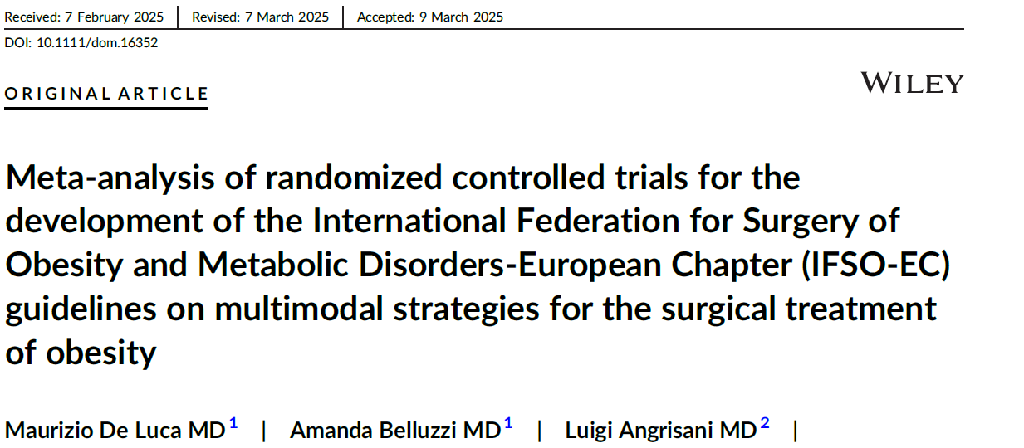
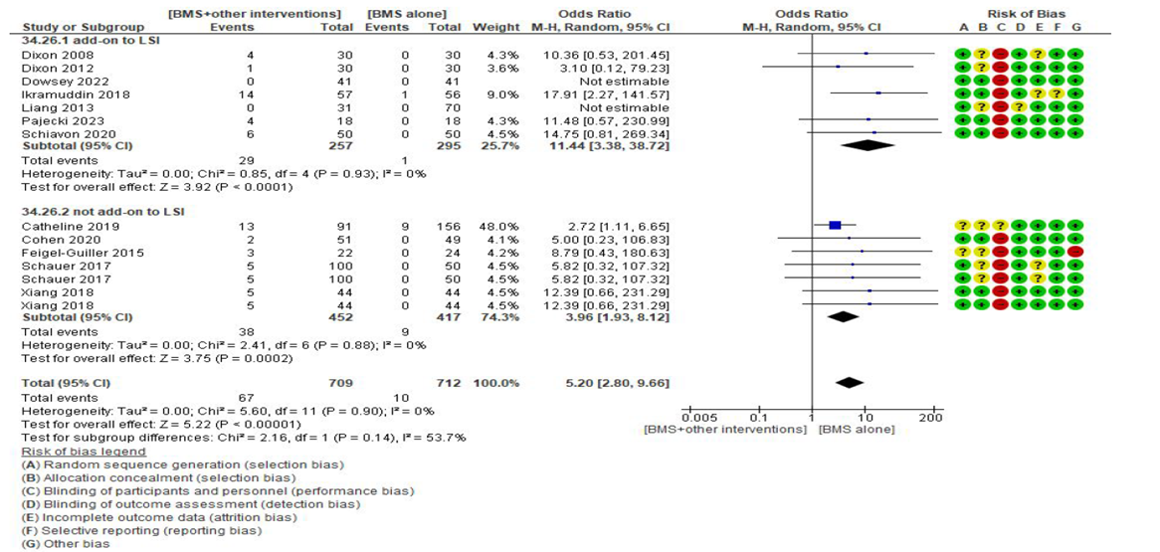
Trattamento Multimodale come Garanzia di Successo
2025
Effects of the addition of LSI to BMS on periprocedural SAEs (Serious Adverse Events) in comparison with matched trials performed with MBS alone.
De Luca M, Belluzzi et al. Meta-analysis of randomized controlled trials for the development of the International Federation for Surgery of Obesity and Metabolic Disorders-European Chapter (IFSO-EC) guidelines on multimodal strategies for the surgical treatment of obesity. Diabetes Obes Metab. 2025 Apr 8.

Slide 19
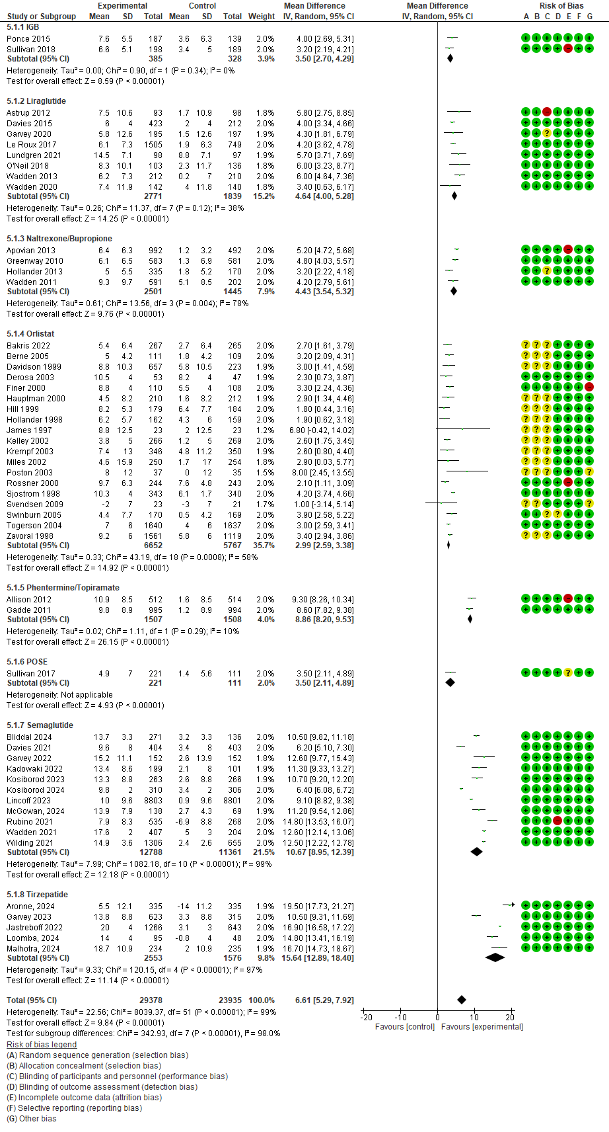
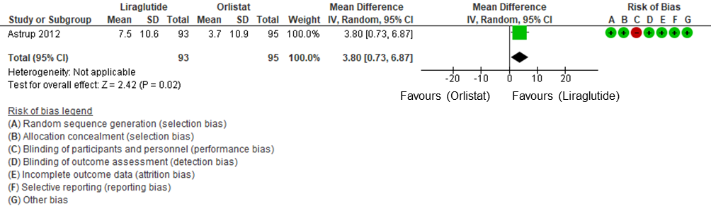
Trattamento Multimodale come Garanzia di Successo
2025
Effects of individual anti-obesity strategy on TBWL% at endpoint in placebo and active controlled trials
De Luca M, Belluzzi et al. Meta-analysis of randomized controlled trials for the development of the International Federation for Surgery of Obesity and Metabolic Disorders-European Chapter (IFSO-EC) guidelines on multimodal strategies for the surgical treatment of obesity. Diabetes Obes Metab. 2025 Apr 8.

Slide 20


Trattamento Multimodale come Garanzia di Successo
“Efficacy and Safety of Approved Surgical, Endoscopic, and Pharmacological Treatments for Obesity and Overweight: A Comprehensive Systematic Review and Network Meta-Analysis of Randomized Controlled Trials”
De Luca M, Belluzzi A et al
Network meta-analysis on effects of individual anti-obesity strategy on TBWL% at endpoint in placebo and active controlled trials. 26-52 weeks
RCTs with BMI at entry 30-34.9 Kg/m²
RCTs with BMI at entry 35-39.9 Kg/m²
RCTs with BMI at entry >39.9 Kg/m²

Slide 21


Trattamento Multimodale come Garanzia di Successo
“Efficacy and Safety of Approved Surgical, Endoscopic, and Pharmacological Treatments for Obesity and Overweight: A Comprehensive Systematic Review and Network Meta-Analysis of Randomized Controlled Trials”
De Luca M, Belluzzi A et al
Network plot for TBWL% at 53-104 weeks. RCTs enrolling diabetic patients
Network plot for TBWL% at 53-104 weeks. RCTs non-enrolling diabetic patients

Slide 22

Trattamento Multimodale come Garanzia di Successo
“Efficacy and Safety of Approved Surgical, Endoscopic, and Pharmacological Treatments for Obesity and Overweight: A Comprehensive Systematic Review and Network Meta-Analysis of Randomized Controlled Trials”
De Luca M, Belluzzi A et al
Network meta-analysis for different anti-obesity strategies. Network plot for TBWL% at 105-156 weeks (RCTs with a mean BMI at entry > 39.9 Kg/m²).
Network meta-analysis for different anti-obesity strategies. Network plot for TBWL% at 157-520 weeks (RCTs with a mean BMI at entry > 39.9 Kg/m²).

Slide 23
Trattamento Multimodale come Garanzia di Successo
“Efficacy and Safety of Approved Surgical, Endoscopic, and Pharmacological Treatments for Obesity and Overweight: A Comprehensive Systematic Review and Network Meta-Analysis of Randomized Controlled Trials”
De Luca M, Belluzzi A et al
Network meta-analysis for different anti-obesity strategies. Network plot for TBWL% at 105-156 weeks (RCTs with a mean BMI at entry > 39.9 Kg/m²)
Network meta-analysis for different anti-obesity strategies. Network plot for TBWL% at 157-520 weeks (RCTs with a mean BMI at entry > 39.9 Kg/m²).

Slide 24









Trattamento Multimodale come Garanzia di Successo
2025
IFSO urges governments, healthcare systems, and global health organizations to recognize obesity as a public health priority and to adopt multimodal, patient-centered care strategies that address the entire continuum of obesity.
De Luca, M., Belluzzi, A., Navarra, G. et al. The Venice Declaration: Obesity as a Disease—A Call to Action for Diagnosis, Multimodal Treatment, and Policy Change. OBES SURG (2025).

Slide 25



Trattamento Multimodale come Garanzia di Successo
Take home messages
“Choices are being framed as ‘either or’ or one-size-fits-all, but combination therapies are common in medicine,
so WHY NOT consider them here?”
2025
“How can we systematically approach this so we can individualize treatment?”
“If this is an opportunity to bring more people in so they can learn about the benefits of bariatric surgery and not be afraid of it, that can increase those numbers”.
“There’s enough room for all of us.”
Schweitzer K. What Does the Rise of GLP-1 Drugs Mean for Bariatric Surgery? JAMA. 2025 Mar 4;333(9):743-745.
Blüher M, Aras M, Aronne LJ, Batterham RL, Giorgino F, Ji L, Pietiläinen KH, Schnell O, Tonchevska E, Wilding JPH. New insights into the treatment of obesity. Diabetes Obes Metab. 2023 Aug;25(8):2058-2072.

Slide 26

Grazie

